Slide 1
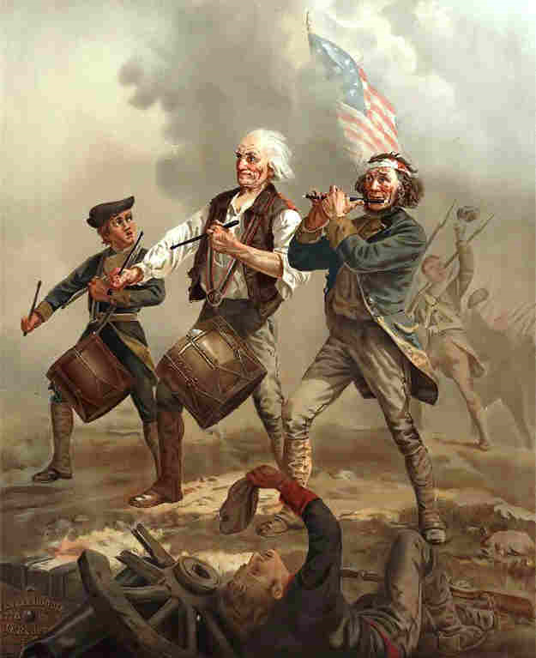
Steps toward the American Revolution

Slide 2
Philosophers inspire revolutionary movement
John Locke

Slide 3
The ideas of John Locke
The period known as the “Enlightenment” in Europe during the seventeenth and eighteenth centuries saw the development of new ideas about the rights of people and their relationship to their rulers. John Locke was an Enlightenment philosopher whose ideas, more than any other’s, influenced the American belief in self-government. Locke wrote the following:
• All people are free, equal, and have “natural rights” of life, liberty, and property that rulers cannot take away

Slide 4
The ideas of John Locke
All original power resides in the people, and they consent to enter into a “social contract” among themselves to form a government to protect their rights. In return, the people promise to obey the laws and rules established by their government, establishing a system of “ordered liberty.”
Government’s powers are limited to those the people have consented to give to it. Whenever government becomes a threat to the people’s natural rights, it breaks the social contract, and the people have the right to alter or overthrow it.

Slide 5
The ideas of John Locke
Locke’s ideas about the sovereignty and rights of the people were radical and challenged the centuries-old practice throughout the world of dictatorial rule by kings, emperors, and tribal chieftains.

Slide 6
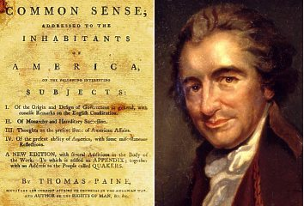
Thomas Paine and Common Sense 1776

Slide 7
Thomas Paine and Common Sense
Thomas Paine was an English immigrant to America who produced a pamphlet known as Common Sense that challenged the rule of the American colonies by the King of England. Common Sense was read and acclaimed by many American colonists during the mid-1700s and contributed to a growing sentiment for independence from Great Britain.

Slide 8
Thomas Paine (summarized)
Important document - “Common Sense”
Paine argues for independence
some 500,000 copies sold
his work, helps to influence public opinion and sway people to support the war…”these are times that try men’s soul” The Crisis

Slide 9
The Declaration of Independence
The eventual draft of the Declaration of Independence, authored by Thomas Jefferson of Virginia, reflected the ideas of Locke and Paine. Jefferson wrote:
“We hold these truths to be self-evident, that all men are created equal, that they are endowed by their Creator with certain unalienable Rights, that among these are Life, Liberty, and the pursuit of Happiness.

Slide 10
The Declaration of Independence
“That to secure these rights, Governments are instituted among Men, deriving their just powers from the consent of the governed.
“That whenever any Form of Government becomes destructive of these ends, it is the Right of the People to alter or abolish it, and to institute new Government….”
Jefferson then went on to detail many of the grievances against the King of England that Paine had earlier described in Common Sense.

Slide 11
The key principles of the Declaration of Independence increased political, social, and economic participation in the American experience over a period of time.
Political participation (equality)
Extending the franchise
Upholding due process of law
Providing free public education
Social participation (liberty)
Abolishing slavery
Extending civil rights to women and other groups
Economic participation (pursuit of happiness)
Regulating the free enterprise system
Promoting economic opportunity
Protecting property rights

Slide 12
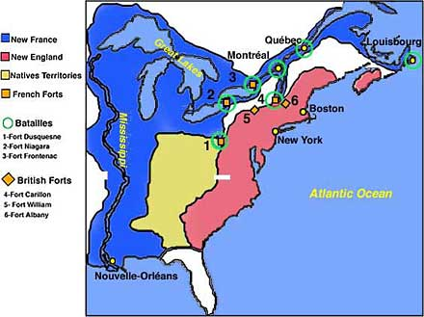
Trouble in the Ohio Valley

Slide 13
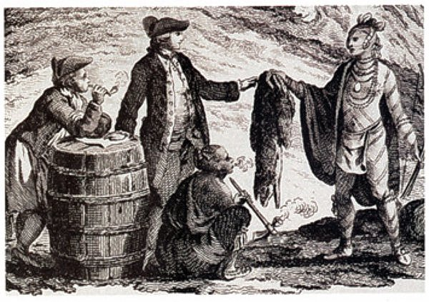
The French Fur Trade
In the 1750’s, the French created a profitable fur trade business in the regions of the Ohio River Valley

Slide 14
Proclamation of 1763
This law said that English colonists could not settle west of the Appalachian’s in the Ohio Valley

Slide 15
Anglo-French rivalry leading to conflict with the colonies
The rivalry in North America between Britain and France led to the French and Indian War, in which the French were driven out of Canada and their territories west of the Appalachian Mountains.
As a result of the war, Britain took several actions that angered the American colonies and led to the American Revolution. These included
the Proclamation of 1763, which prohibited settlement west of the Appalachian Mountains, a region that was costly for the British to protect.
new taxes on legal documents (the “Stamp Act”), tea, and sugar, to pay costs incurred during the French and Indian War and for British troops to protect colonists.

Slide 16
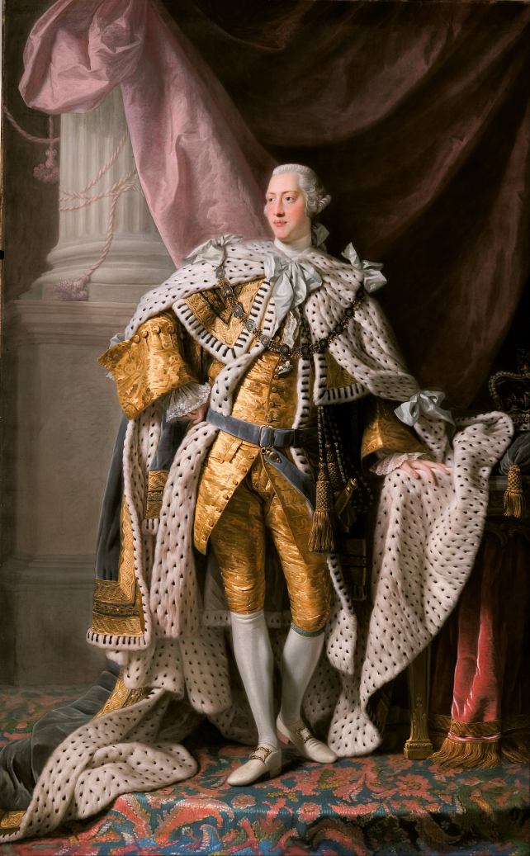
New acts seem unfair
Britain was heavily in debt and looked to their colonies to help pay for the war (taxes)
They will pass more laws without the consent of the governed
King George III

Slide 17
***

Slide 18
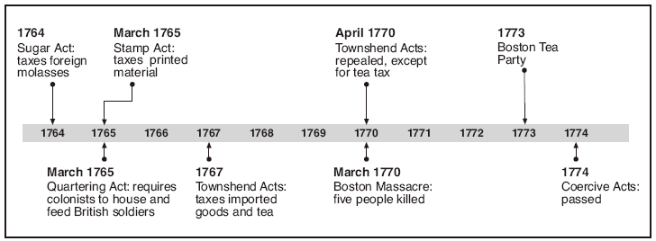
Timeline of events

Slide 19
The beginning of the American Revolution
Resistance to British rule in the colonies mounted, leading to war:
The Boston Massacre (1770) took place when British troops fired on anti-British demonstrators.
The Boston Tea Party (1773) occurred.
The First Continental Congress was called, to which all of the colonies except Georgia sent representatives—the first time most of the colonies had acted together.
War began when the “Minutemen” in Massachusetts fought a brief skirmish with British troops at Lexington and Concord.

Slide 20
THINGS WORSEN IN THE COLONIES
Taxes led to protest by the colonists
Leading members of the colonies consider breaking away from England
Patrick Henry of Virginia, “NO TAXATION WITHOUT REPRESNTATION”

Slide 21
Taking Sides

Slide 22
Differences among the colonists
The colonists were divided into three main groups during the Revolution:
Patriots
Believed in complete independence from Britain
Inspired by the ideas of Locke and Paine and the words of Virginian Patrick Henry (“Give me liberty, or give me death!”)
Provided the troops for the American Army, led by Virginian George Washington
Loyalists (Tories)
Remained loyal to Britain because of cultural and economic ties
Believed that taxation of the colonies was justified to pay for British troops to protect American settlers from Indian attacks
Neutrals
The many colonists who tried to stay as uninvolved in the war as possible

Slide 24
Colonist prepare to fight
In Boston, colonial militia (minutemen) begin to prepare for conflict by storing arms
When the British move into the countryside, the are warned by Paul Revere
“Shots heard around the World”

Slide 26
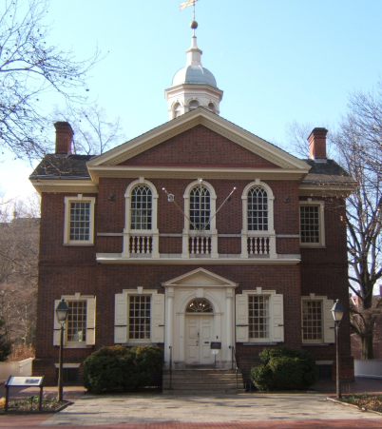

Slide 27
The War Begins
2nd Continental Congress meets in Philadelphia, May 1775. Washington appointed Commander of the Army

Slide 28
Declaration of Independence July 4, 1776 - Philadelphia

Slide 29
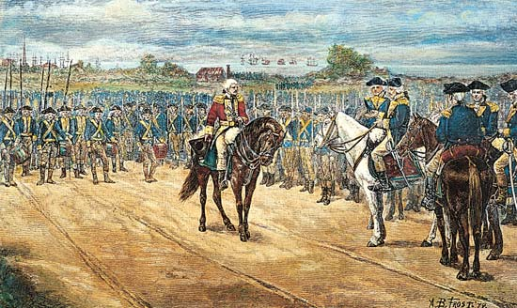

Slide 32
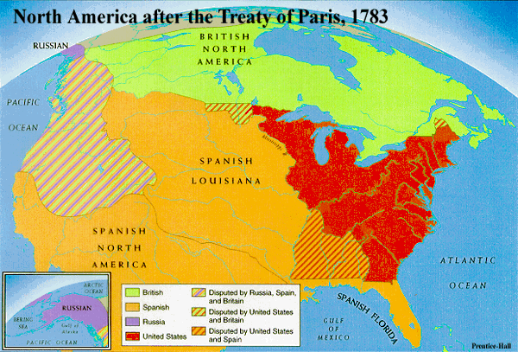

Slide 33
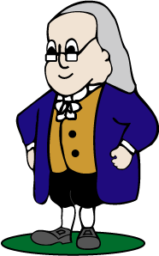
Factors leading to colonial victory
Diplomatic
Benjamin Franklin negotiated a Treaty of Alliance with France.
The war did not have popular support in Great Britain.

Slide 34
Factors leading to colonial victory
Military
George Washington, general of the American army, avoided any situation that threatened the destruction of his army, and his leadership kept the army together when defeat seemed inevitable.
Americans benefited from the presence of the French army and navy at the Battle of Yorktown, which ended the war with an American victory.

Slide 35
Key People
Patrick Henry-”Give me liberty or give me death”
Ben Franklin-Alliance with the French…D of I …Treaty of Paris
John Adams-Massachusetts leader & the D of I
Thomas Jefferson-Author of the Declaration
George Washington-Military commander from Virginia who led his troops throughout the entire war
George III-King of England during the American revolution

